Slide 1


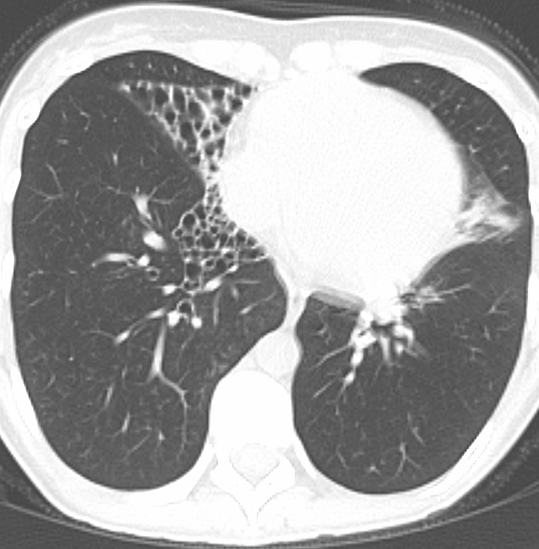
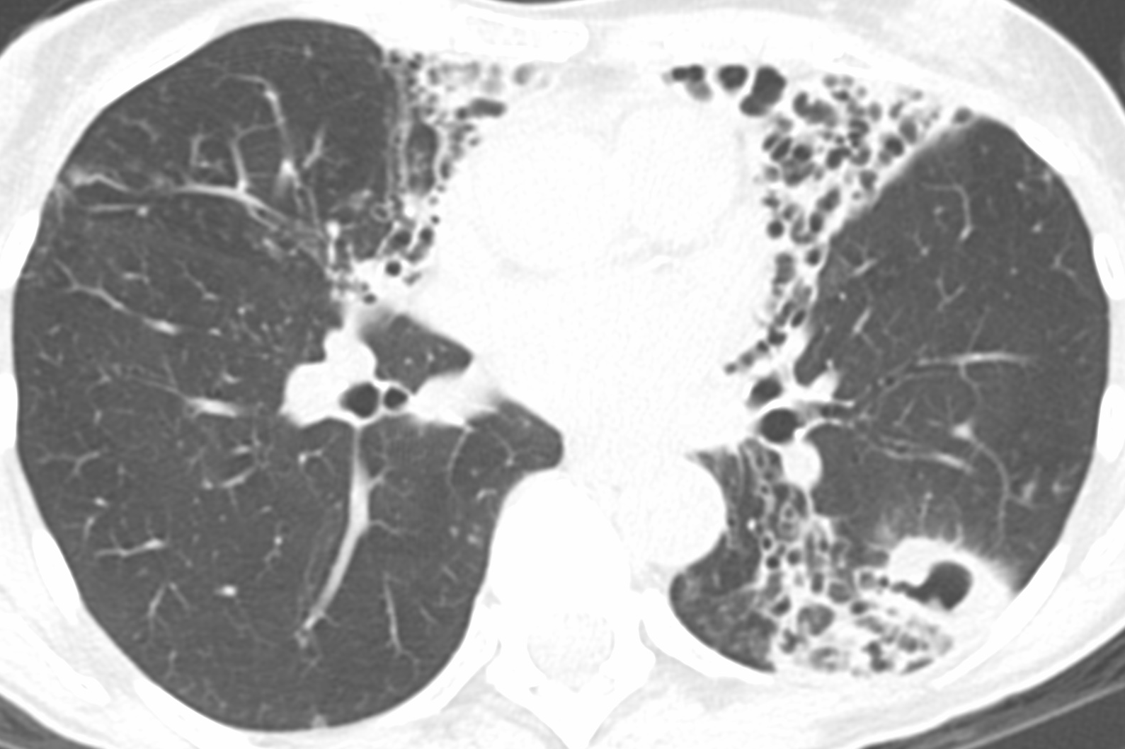
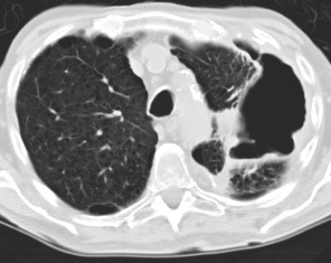
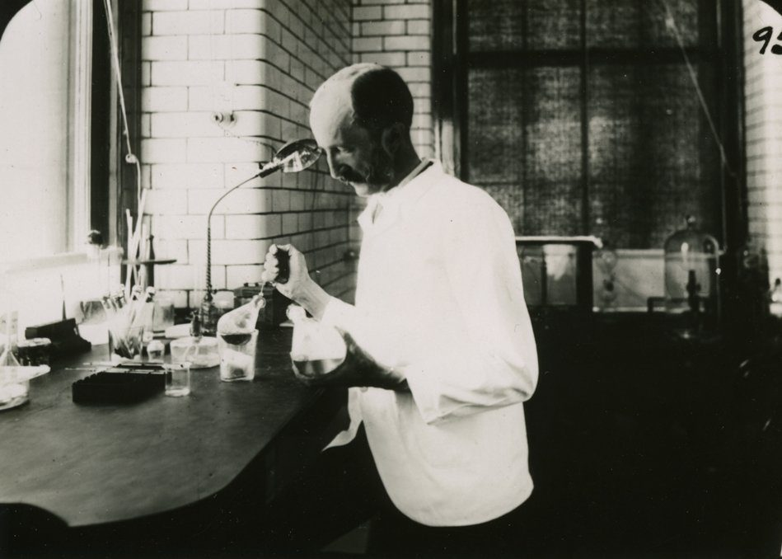
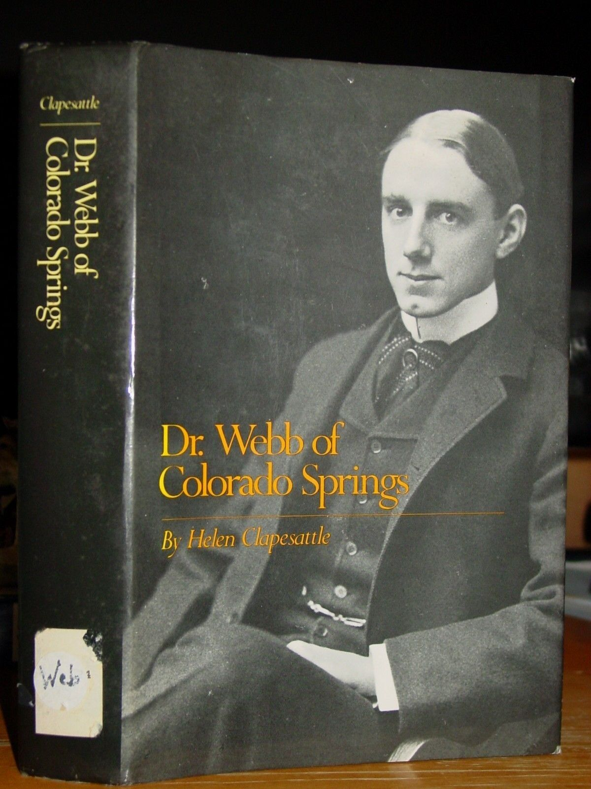
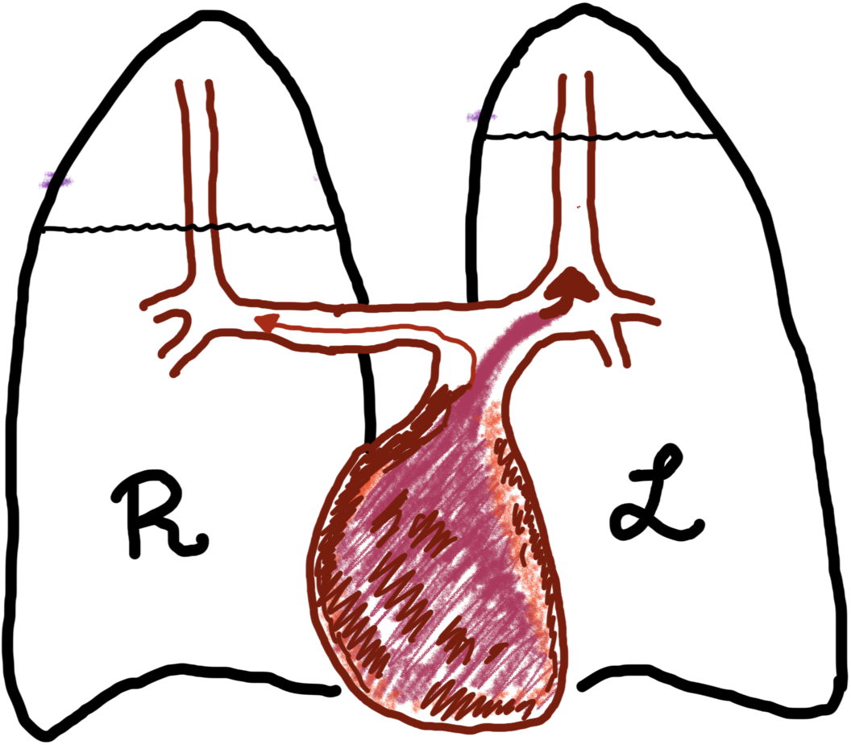
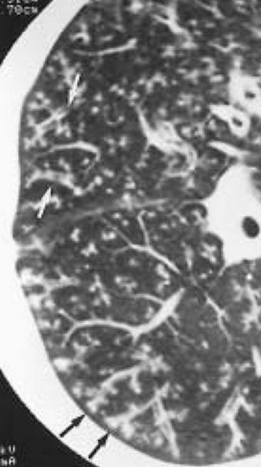
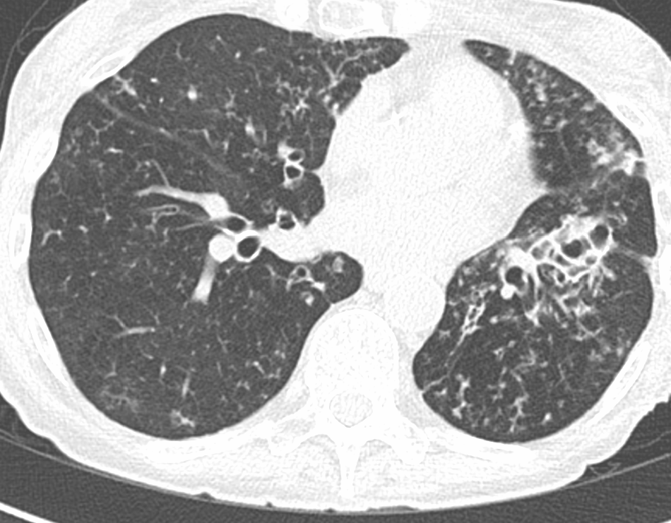
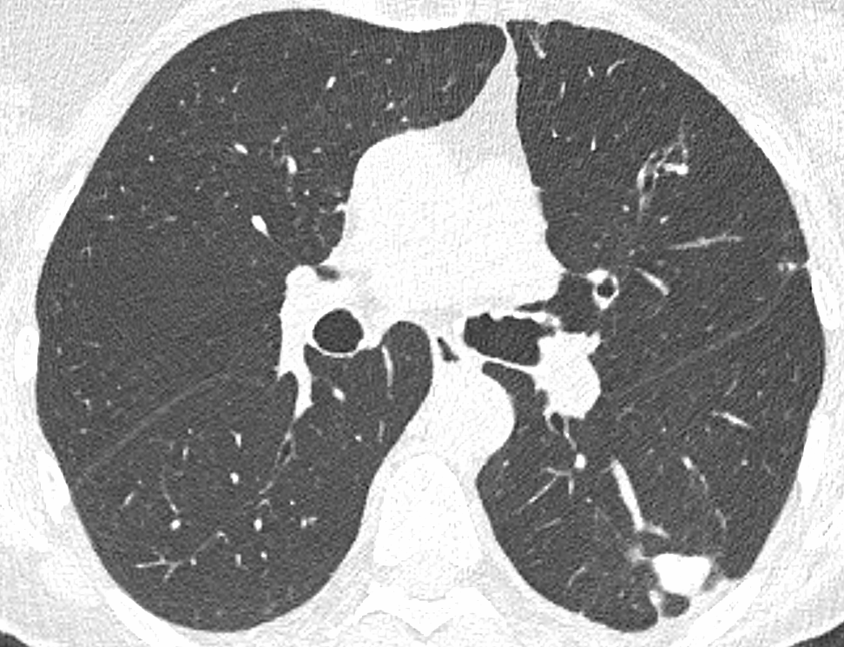
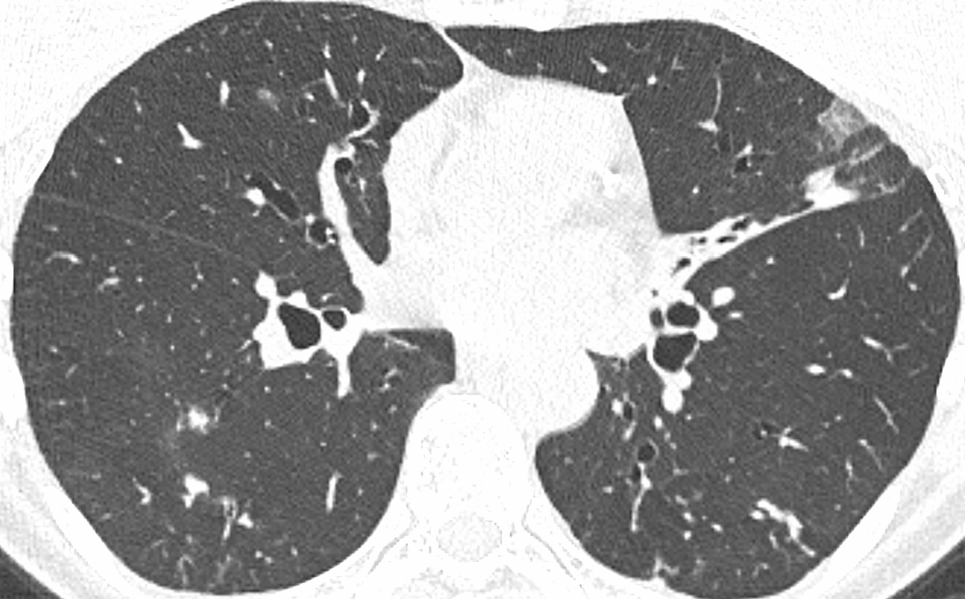
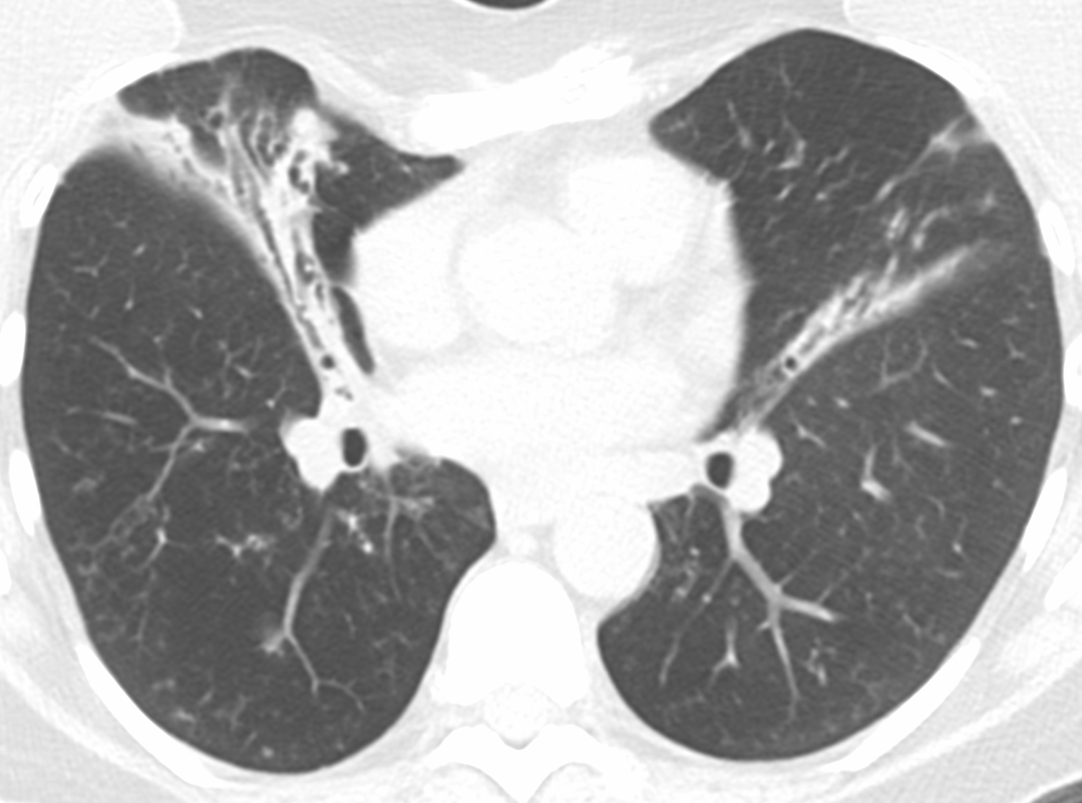
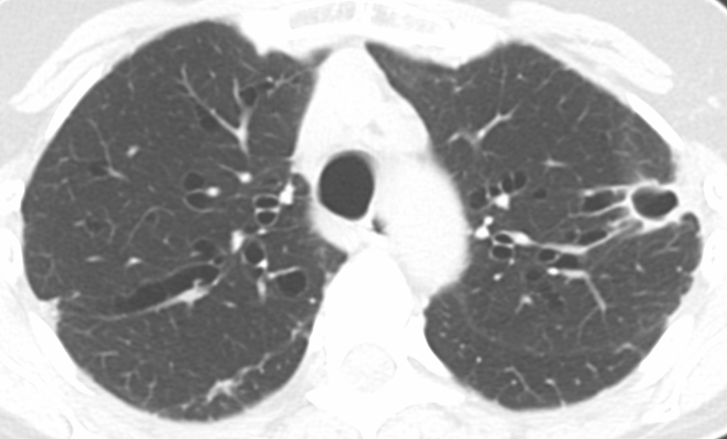
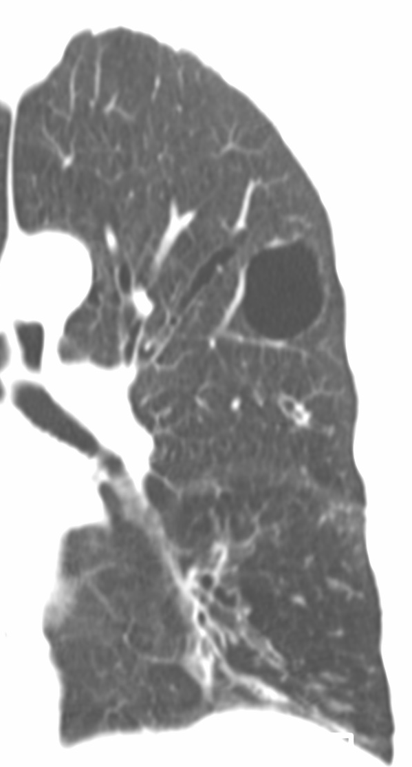
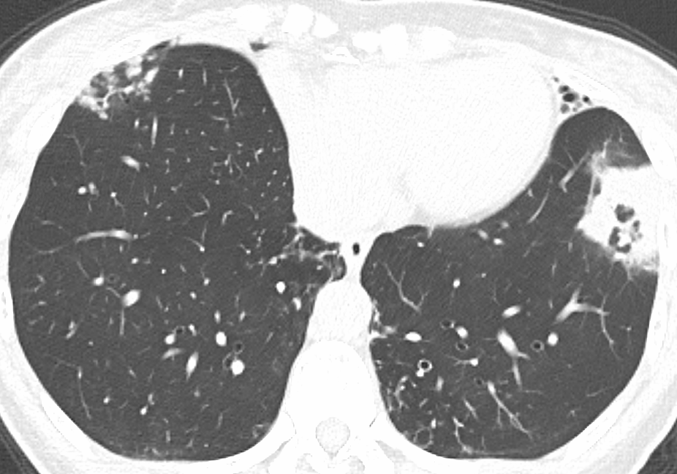
Chest CT analysis of lung disease due to non-tuberculous mycobacteria
Edward D. Chan, Kum Ju Chae, Valerie Hale, Drew E. Narum, Jared J. Eddy, Matthew J. Strand, Tilman Koelsch, Jiwon Lyu
Rocky Mountain Regional Veterans Affairs Medical Center, Aurora, CO; National Jewish Health, Denver, CO; University of Colorado Anschutz Medical Campus, Aurora, CO; Jeonbuk National University Hospital, Jeonju, South Korea; Soon Chun Hyang University Cheonan Hospital, Cheonan, Korea
ABSTRACT
QUESTIONS
RESULTS – tabulation
SUMMARY
RATIONALE: Non-tuberculous mycobacteria lung disease (NTM-LD) is associated with several radiographic features including bronchiectasis, nodules with and without cavitation, centrilobular nodules (tree-in-bud opacities), ground-glass opacities, consolidation, and fibrocavitary (often upper lobe) disease. Based on lung surgical literature, the right middle lobe, lingula, and right upper lobe (in various orders) are the more common lobes that are resected with intent to cure or better control of the infection, indicating indirectly that these lobes are most severely affected. However, the prevalence of the different radiographic features with each lobe has not been systematically analyzed. METHODS: In a pilot study, a chest radiologist and a pulmonologist with special interest in NTM-LD independently analyzed the latest-available high-resolution chest CT scans of 50 consecutive patients with NTM-LD for each of the aforementioned radiographic features for each lobe (lingula counted as a separate lobe) and scored their severity semi-quantitatively using a numeric score: Grade 0 for none; Grade 1 for <25% involvement of the lobe; Grade 2 for 25-50%; Grade 3 for >75%. For any differences in scoring, a consensus in scoring was achieved by in-person discussion while viewing the relevant CT scan. Basic demographics and microbiologic data obtained included gender, age, culprit NTM species identified, prior to and peri-period of the chest CT analyzed. RESULTS: For the first 71 NTM-LD patients, there were 64 women and 7 men. The number of patients [average age, years] with the culprit NTM included: 40 [67.6 years] Mycobacterium avium complex (MAC), 17 [65.2 years] M. abscessus group (mostly subsp. abscessus and subsp. massiliense), 7 [71.4 years] with both MAC and M. abscessus group; and 7 [62.7 years] with other NTM (2 M. kansasii, 1 M. lentiflavum, 1 M. fortuitum, and 3 M. simiae). The three most commonly involved lobes for each of the radiographic features were: bronchiectasis (RML, lingula, RUL); centrilobular nodules / tree-in-bud opacities (RLL, RML, LLL); consolidation (lingula, RLL); and large nodules (RLL, LLL, RUL). For cavitary disease, RUL, RLL, LUL, and LLL were most affected, with 11, 6, 4, and 4 cavities, respectively. CONCLUSIONS: Our findings confirmed that severe bronchiectasis, a common indication for lung resection, most commonly involves the RML, lingula, and RUL. However, because cavitation was not found in the RML and lingula but was most commonly found in the RUL, we posit that physical-chemical factors contribute to the formation of cavities, as has been proposed for tuberculosis.
Are there differences in the frequencies and severities for each of the specific CT features among the lung lobes in NTM-LD?
Are there differences in (1) between MAC-LD and M. abscessus-LD?
Table 3. Distribution of CT features (reported as number of lobes involved) with MAC + MAB-LD and Other NTM (top three lobes involved are shaded)
The frequency of CT phenotype in 71 patients with NTM-LD:
MAC-LD: NB without cavitation >>> NB with cavitation ~ FC disease
MAB-LD: NB without cavitation >>> NB with cavitation > FC disease
Bronchiectasis was significantly more severe in the RML and lingula
RML significantly more severe vs. all other lobes
Lingula more severe vs. LLL, LUS and RLL
Demographic and radiographic features were not significantly different between MAC-LD, MAB-LD, and Other NTM-LD.
 | MAC+MAB LD (n= 7) |  |  |  |  |  |  | Other NTM-LD (n= 7)
 | RUL | RML | RLL | LUS | lingu | LLL | Sum | RUL | RML | RLL | LUS | lingu | LLL | Sum
Tree-in-bud | 7 | 6 | 6 | 7 | 5 | 6 | 37 | 6 | 4 | 7 | 5 | 5 | 6 | 33
Nodule ≥10 mm | 3 | 0 | 1 | 1 | 0 | 1 | 6 | 0 | 1 | 2 | 0 | 0 | 1 | 4
GGO | 2 | 1 | 0 | 2 | 0 | 0 | 5 | 1 | 0 | 3 | 2 | 2 | 3 | 11
Consoli-dation | 3 | 2 | 3 | 2 | 3 | 2 | 15 | 1 | 1 | 3 | 1 | 3 | 4 | 13
BXSIS | 7 | 6 | 5 | 3 | 5 | 4 | 30 | 7 | 6 | 6 | 3 | 6 | 5 | 33
Ateletasis | 2 | 4 | 0 | 0 | 5 | 0 | 11 | 1 | 3 | 2 | 1 | 4 | 1 | 12
METHODS (CT scoring)
In a pilot study, we classified the chest CT scans (pre-surgical, latest available) of 71 (consecutive) patients with NTM-LD as: (i) nodular-bronchiectasis, (ii) nodular bronchiectasis with nodular cavitation, (iii) fibrocavitary disease, or (iv) unclassifiable.
We semi-quantified the severity of five CT features: (i) tree-in-bud opacities, (ii) GGO, (iii) consolidation, (iv) bronchiectasis, & (v) atelectasis for each of the six lobes (lingula counted separately) into four Grades: Grade 0 (none), Grade 1 (<25% involved), Grade 2 (25-50%), and Grade 3 (>50%).
We tabulated for the presence (Y) or absence (N) of four CT features: (i) nodules ≥ 1 cm, (ii) thin-wall cavity, (iii) thick-wall cavity, and (iv) mosaicism for all six lobes.
Table 4. Distribution of cavities in MAC-LD, MAB-LD, both, and Other NTM-LD
 |  |  | MAC-LD (n= 40 ) | MAB-LD (n= 17 ) | MAC+MAB LD (n= 7 ) | Other NTM-LD (n= 7)
Thin wall cavity (wall < 3 mm) | Size (mm) |  | 8.4 (5.0–11.7) | 33.0 | 6.0 (5–7) | 31.3 (19–47)
 | Location | RUL | 1 | 0 | 0 | 2
 |  | RML | 0 | 0 | 0 | 2
 |  | RLL | 0 | 0 | 2 | 0
 |  | LUS | 1 | 0 | 0 | 1
 |  | lingula | 0 | 0 | 0 | 1
 |  | LLL | 0 | 1 | 0 | 0
Thick wall cavity (wall ≥ 3 mm) | Size (mm) |  | 43.4 (20–95) | 45.7 (27–92) |  | 18.0 (13–25)
 | Location | RUL | 4 | 3 | 0 | 1
 |  | RML | 0 | 0 | 0 | 0
 |  | RLL | 1 (SS-RLL) | 2 (1 SS-RLL) | 0 | 1
 |  | LUS | 1 | 1 | 0 | 0
 |  | lingula | 0 | 0 | 0 | 0
 |  | LLL | 1 | 1 | 0 | 1
Key Finding and Hypothesis
The RUL appears particularly vulnerable:
It is the single lobe most commonly affected by cavitation.
Because the RUL is also more severely affected by bronchiectasis and consolidation compared to the LUS, we posit that physical-chemical factors that make the RUL more unique in the upright human predispose the RUL to cavitary NTM-LD.
BACKGROUND
Three main radiographic patterns for NTM-LD
METHODS (statistical analyses)
MAC-LD=Mycobacterium avium complex-lung disease; MAB-LD=Mycobacterium abscessus-lung disease
BXSIS=bronchiectasis; GGO=gound glass opacities; RUL=right upper lobe; RML=right middle lobe; RLL=right lower lobe; LUS=left upper lobe segments; lingu=lingula; LLL=left lower lobe; SS=superior segment
Demographic variables and total occurrences by disease feature types were compared between NTM species groups using Fisher’s Exact test, t-tests or ANOVA.
Occurrences by lobe were modeled using ordinal logistic regression, including a random intercept for subject to account for multiple measures per subjects (a generalized linear mixed model). Lobes were compared using t-tests derived from these models. Separate models were fit for each CT feature.
Potential health implications of our key finding…posed as questions
Nodular bronchiectasis
Nodular bronchiectasis
with nodular cavitation
Fibrocavitary disease
RESULTS - analyses
The RML and lingula had greater severity of bronchiectasis:
RML had significantly higher grade vs. all other lobes, p<0.05.
Lingula had significantly higher grade vs. LLL, LUS and RLL, p<0.05.
The RUL was more severely affected by bronchiectasis (OR=5.62, 95% CI: 2.6 to 12.1) and consolidation (OR=3.09, 95% CI: 1.26 to 7.58) than the LUS.
There were no significant differences between NTM species groups for sex, age, tree-in-bud, nodules ≥ 10 mm, GGO, consolidation, bronchiectasis, atelectasis, and cavities (p>0.10 for all).
Should NTM-LD patients with cavities in the upper lobe(s) or in the superior segments of the lower lobe(s) refrain from excessive exercise?
Should they be lying down more when resting?
Should they be lying down when getting IV (or inhaled) antibiotics?
I know I have hurt nobody by rest, but I am quite sure I often have by allowing them to exercise (Edward Livingston Trudeau, MD, 1848-1915).
A good rule is the following: Never stand when you can sit, never sit when you can lie down (Webb GB & Ryder CT. Overcoming TB: An Almanac of Recovery, 3rd edition, 1927).
Lobar distribution of NTM-LD (literature) (the RML, lingula, and RUL most commonly involved)
# of patients | Patient population | # lobes analyzed* | Frequency of involvement | REF
24 non-surgical subjects | Immunocompromised with NTM-LD | 143 lobes | RML > lingula > LUL | PMID: 23440166
24 non-surgical subjects | Immunocompetent with NTM-LD | 144 lobes | RUL > RML > lingula | PMID: 23440166
55 non-surgical subjects | With MAC-LD | Not stated | RML > RUL > lingula | PMID: 7790541
128 non-surgical subjects | NTM-LD | Not stated | RUL (51%), RML (46%), RLL (39%), lingula (36%), LUL (32%), and LLL (6%) | PMID: 18498789
236 surgical patients and 265 lung resections | NTM-LD subjects who underwent lung resection: 126 lobectomies, 55 segmentectomy, 44 pneumonectomy, 40 mixed procedures | Not stated | Resections in: 71 RML, 46 lingula, 27 RUL, 20 lobectomy + segmentectomy, 18 bilobectomy, 27 right pneumonectomy, 17 left pneumonectomy | PMID: 10915685
101 non-surgical subjects | With MAC and MAB lung disease | Not stated | RUL (87.1%), lingula (86.1%), RML (84.2%), RLL (84.2%), LUL (81.2%), and LLL (84.2%) | PMID: 35862353
87 non-surgical subjects | With MAC and MAB lung disease | Not stated | RUL > RLL > RML > LLL > LUL > lingula ** | PMID: 16224151
RESULTS – tabulation
Table 1. Patient characteristics
 | MAC-LD (n= 40) | MAB-LD (n= 17) | MAC+MAB LD (n= 7) | Others (n= 7) | p-value
Age (median, years) | 67.6 ± 8.3 | 65.2 ± 10.6 | 71.4 ± 6.3 | 62.7 ± 6.8 | 0.22
Female sex | 36 (90%) | 17 (100%) | 6 (85.7%) | 5 (71.4%) | 0.12
Table 2. General classification of NTM-LD
Hypothesis on why NTM (and TB) cavities may be more common in the upper lobes (with RUL > LUL)…
 | MAC-LD (n= 40) | MAB-LD (n= 17) | MAC+MAB-LD (n= 7) | Others (n= 7) | p-value
NB type with cavity | 3 (7.5%) | 3 (17.6%) | 1 (14.3%) | 1 (14.3%) | 0.84
NB type w/o cavity | 28 (70%) | 11 (64.7%) | 6 (85.7%) | 5 (71.4%)
FC type | 3 (7.5%) | 2 (11.8%) | 0 | 1 (14.3%)
Unclassified | 6 (15%) | 1 (5.9%) | 0 | 0
*lingula counted as a separate lobe, ** small nodules, tree-in bud pattern involvement
The upper lobes have increased risk of cavitation due to increased mechanical stress / alveolar size, decreased blood perfusion (→ decreased influx of immune cells), decreased lymph formation (→ increased accumulation of mycobacteria and their antigens), and increased P_{A}O₂ (→ increased NTM growth) in the upright individual.
Radiologic features of NTM-LD include:
MAC-LD=Mycobacterium avium complex-lung disease; MAB-LD=Mycobacterium abscessus-lung disease
NB=nodular bronchiectasis CT phenotype; FC=fibrocavitary CT phenotype
Tree-in-bud opacities &
centrilobular nodules
Large nodules (≥1cm)
Ground glass opacities
Mosaicism
(air trapping)
Table 3. Distribution of CT features (reported as number of lobes involved) with MAC-LD and MAB-LD (top three lobes involved are shaded)
40X
4X
0.07
0
*
*
0
132
 | MAC-LD (n= 40) |  |  |  |  |  |  | MAB-LD (n= 17)
 | RUL | RML | RLL | LUS | lingu | LLL | Sum | RUL | RML | RLL | LUS | lingu | LLL | Sum
Tree-in-bud | 23 | 30 | 33 | 25 | 23 | 29 | 163 | 11 | 12 | 11 | 10 | 13 | 12 | 69
Nodule ≥10mm | 5 | 3 | 9 | 5 | 3 | 7 | 32 | 1 | 1 | 2 | 0 | 1 | 3 | 8
GGO | 6 | 5 | 8 | 5 | 4 | 8 | 36 | 3 | 3 | 5 | 2 | 3 | 3 | 19
Consolidation | 14 | 14 | 11 | 8 | 11 | 10 | 68 | 8 | 6 | 6 | 4 | 8 | 5 | 37
BXSIS | 24 | 29 | 23 | 17 | 28 | 18 | 139 | 14 | 15 | 10 | 9 | 14 | 8 | 70
Atelectasis | 1 | 18 | 1 | 2 | 17 | 3 | 42 | 5 | 8 | 0 | 3 | 9 | 1 | 26
1X
1X
1.30
24
+++
89
Bronchiectasis
Atelectasis
Thick- and thin-walled cavities
Expiratory – air trapping
NTM
cavity
Mechanical
stress
Alveolar size
Perfusion
(L/min)
PA pressure
(mmHg)
The blood flow via the RIGHT pulmonary artery is more tortuous. Asterisks = levels above which PA blood flow cannot be maintained in upright individuals.
Lymph
flow
P_{A}O₂
(mmHg)
Consolidation
New York
Edward Livingston Trudeau, M.D.
Gerald B. Webb, M.D.
MAC-LD=Mycobacterium avium complex-lung disease; MAB-LD=Mycobacterium abscessus-lung disease
BXSIS=bronchiectasis; GGO=gound glass opacities; RUL=right upper lobe; RML=right middle lobe; RLL=right lower lobe; LUS=left upper lobe segments; lingu=lingula; LLL=left lower lobe

